Slide 2
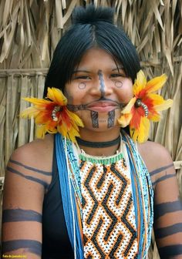
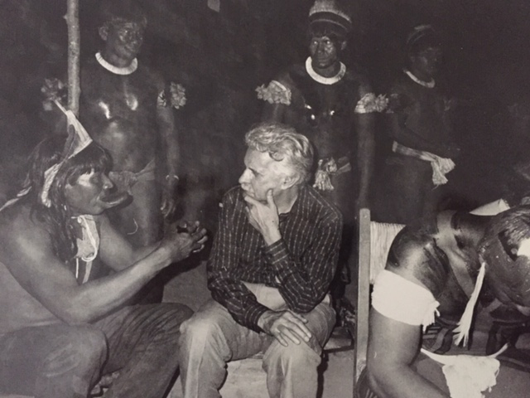
HIV Among Indigenous Populations in Brazil: how to overcome data gaps
M. Cristina Pimenta
HIV/AIDS/VH Coordination, DCCI/Brazilian Ministry of Health
Share your thoughts on this presentation with #IAS2019
Chief Raoni, Caiapó People, Mato Grosso, Brazil, 1985.
Adolescent Girl, Karajá People, 2017.

Slide 3
Presentation Overview
Size of populations, geographical distribution and languages
Health policies
Social and cultural determinants of health
HIV and AIDS data
Sexuality
Conclusion

Slide 4
Introduction
The population Census conducted by the Brazilian Institute of Geography and Statistic (IBGE),registered 896.9 thousand indigenous people in 2010 (4.6% of total country population at the time).
36.2% live in urban areas and 63.8% in rural areas.
Of the grand total, 817.9 thousand are self declared indigenous based on skin color/ race category of the 2010 Census (which serve as a basis for comparisons with the 1991 and 2000 Censuses).
An additional 78.9 thousand people have declared of another skin color or race ( mainly pardos) and identified as indigenous considering they lived on indigenous lands, and based on socio-cultural aspects such as traditions, customs, culture and ancestors.
Notes:
Note: The data gap begins here, where the demographic census data collection also presents its limitations: 1. due to self declaration of race/skin color or ethinicity ; 2 . Existance of populations who dont have contact with the predominat society.

Slide 5
Population Growth
Despite the precariousness of data, it is evident that the situation of indigenous population growth improved.
Studies evidence significant population growth and a historical reversal in indigenous demography in the country since the 1970s, when there was an alarming prognosis expecting the extinction of indigenous peoples.
Since the 1980’s we were able to observe an exponential growth of indigenous peoples, with a growth rate of 3.5% per year during the period of 1996-2000. (Azevedo, M., 2000)

Slide 6
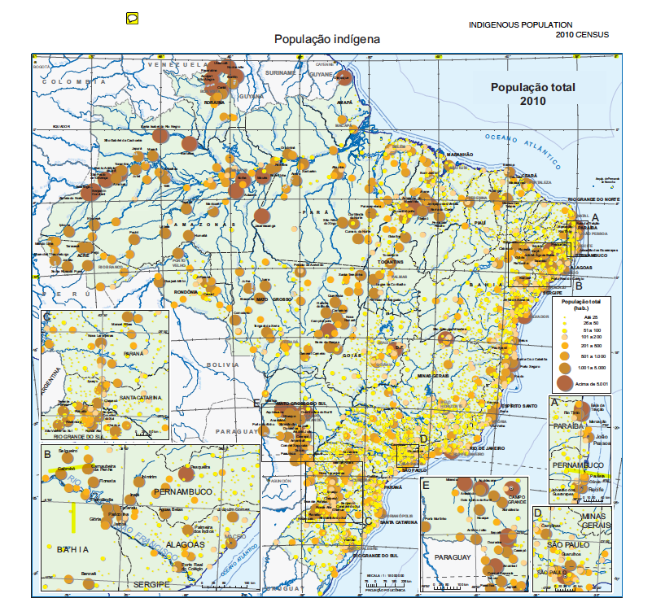
Geographical distribution of indigenous population. Brazil, 2010 census
The 896.9 thousand peoples are distributed in at least 305 ethnical groups and speak 274 different languages.
732,262 indigenous people are distributed in 5,614 villages in 688 indigenous lands (60.4% regularized), occupying 12.6% of the Brazilian territory.

Slide 7
Demographics: age distribution
The indigenous age pyramid in Brazil has a broad base and decreases with age in a pattern that reflects a young indigenous population with high fertility and high mortality rates, greatly influenced by the rural population.
In rural areas, the proportion of indigenous people in the age group 0 to 14 (45.0%) was twice than the urban areas (22.1%), with the opposite occurring in the 65 years or more (4.3% in rural and 7.0% in urban).
The age pyramid for residents outside indigenous lands indicates lower fecundity and mortality. In indigenous lands, the mean age was 17.4 years and, in the main land, 29.2 years.

Slide 8
Social Determinants
Literacy
The Indigenous population has lower educational levels than the non-indigenous, especially in rural areas. In indigenous lands, in the age groups over 50 yrs, the illiteracy rate is higher than the literacy.
Among the natives, 6.2% had no birth registration, but 67.8% were registered in a notary's office. In urban areas rates are close to those of the general population, both above 90%.
Health and Sanitation
In Brazil, 60.3% of indigenous households had a general water supply network, compared to 82.9% of non-indigenous people. Indigenous households, mainly in rural areas, present the largest deficits in sanitary sewage, with predominance of rudimentary services (65.7%).
http://www.saude.gov.br/saude-indigena/saneamento-e-edificacoes/dseis. Accessed July, 2, 2019.

Slide 9
Social Determinants
Health data for the indigenous population is alarming, presenting morbidity and mortality rates three to four times higher than the general population. High levels of infectious diseases, alcoholism and suicide.
Income
Income analysis shows the need to have a differentiated view of the Indigenous peoples. 52.9% report having no income, with a greater proportion in rural areas (65.7%);
However, many factors make it difficult to obtain precise information about their income: many jobs are done collectively, leisure and work are not easily separated and their relation to the land has enormous meaning, without the notion of private property of the predominant society.
Source: (IBGE,2010; 2019) 2010 Census: General Indigenous Characteristics –http://www.ibge.gov.br/home/estatistica/populacao/censo2010/caracteristicas_gerais_indigenas/default_caracteristicas_gerais_indigenas.shtm

Slide 10
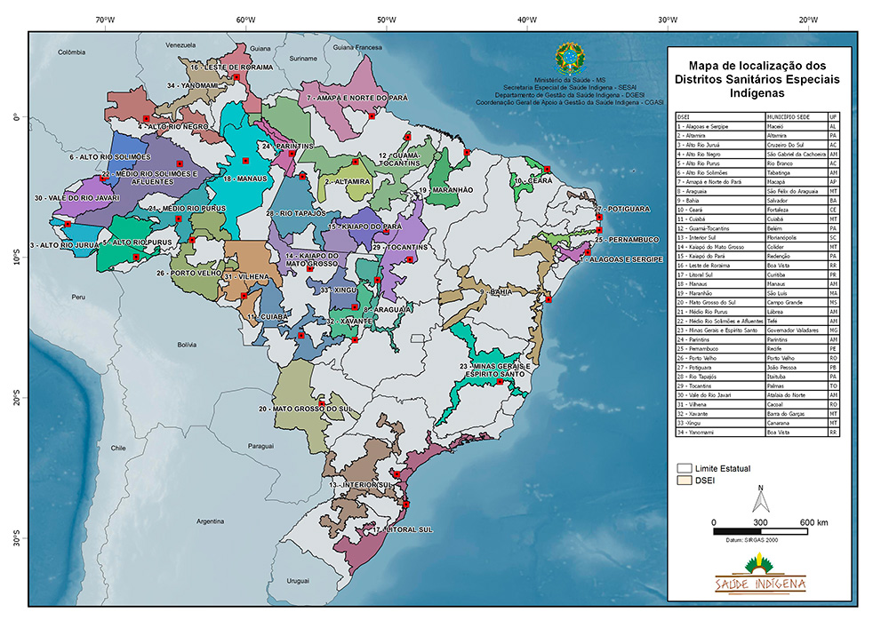
Special Secretariat for Indigenous Health
The Ministry of Health of Brazil has a Special Secretariat for Indigenous Health(Sesai) responsible to coordinate and implement the National Policy on Health Care of Indigenous Peoples, and manage the Subsystem of Health Care (SasiSUS) integrated in the Unified Health System (SUS).
It’s a decentralized system, with administrative and financial autonomy, responsible for 34 Special Indigenous Health Districts (DSEIs).
Notes:
Sesai's responsibilities include: provision of comprehensive care for indigenous health; health education in line with national health policies and programs observing indigenous traditional health practices; sanitary surveillance, health promotion and prevention actions, and management of “ temporary indigenous homes” used while undergoing outpatient treatment.

Slide 11
Indigenous Health Care Information System (SIASI)
The Indigenous Health Care Information System (SIASI) is composed of primary data collected from the primary health care provided by the Multidisciplinary Indigenous Health Teams (EMSI) within the Subsystem of Attention to Indigenous Health (SasiSUS), managed by the Special Indigenous Health Secretary (Sesai) of the Ministry of Health.
MoH also uses the national data systems for compulsory disease notifications (SINAN) and the mortality notification system (SIM).
HIV/AIDS data is captured from SINAN, SIM and the system for management and control of HIV medication distribution- SICLOM.
These data systems request the notification for race/skin color based on the person’s self-declaration.
*http://portalsinan.saude.gov.br/
Notes:
So how is health data collected. The MoH has a special secretariar for indigenous health that collects information from the 34 special indigenous health or sanitary districts- DSEIs.
And in addition, different departments of the ministry of health also access primary data from the local and national disease notificationand mortality notification systems.

Slide 12
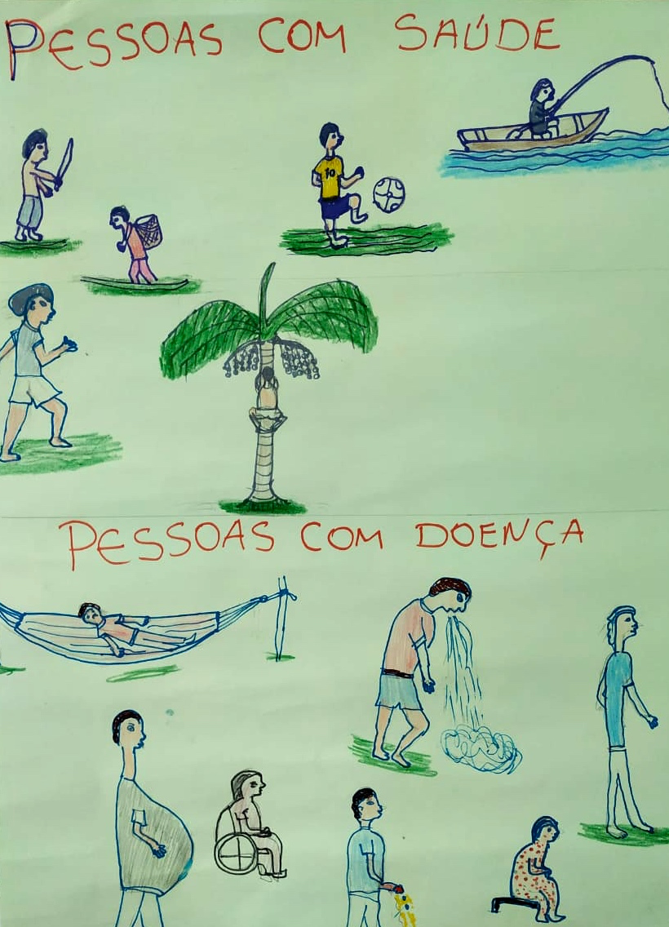
Health and the Ticuna
Healthy people
Unhealthy people
Source: Drawings from a Workshop with Ticuna people for elaboration of educational material ( BR MoH/UNESCO; May 2019)

Slide 13
The Social Body
The Ticuna people are the largest Indigenous ethnic group in Brazil.
This a social representation of their perception as Indigenous people living in large urban areas.
Source: Drawings from a Workshop with Ticuna people for elaboration of educational material ( BR MoH/UNESCO;2019)
Notes:
On the right side of the drawing we have their social identity as Indigenous people and on the left their identity within the broader society.

Slide 14
HIV DATA

Slide 15
HIV and Syphilis
A study conducted by Benzaken et al.,(2017) in nine indigenous health districts of the Brazilian Amazon estimated prevalence for both HIV and Syphilis.
45,967 indigenous people were tested, the mean age was 22.5 years (standard deviation: 9.2), and 56.5% of the population were female.
Overall HIV prevalence was 0.13% (57/43,221), and for syphilis 1.82% (745/40,934).
HIV prevalence in men was 0.16%, in women 0.11, and for pregnant women 0.07%,
Syphilis in men 2.23%, women 1.51%, and pregnant women 1.52%,
The district Vale do Javari had the highest prevalence of both infections (HIV: 3.38%, syphilis: 1.39%).
The study also showed that contextual factors such as poverty, contact with the larger society- mobility, violence and lack of health services affected these outcomes.
Benzaken, A., et al “HIV and syphilis in the context of community vulnerability among indigenous people in the Brazilian Amazon”. International Journal for Equity in Health (2017) 16:92.

Slide 16
HIV treatment cascade based on PLHIV linked to health services, by self-reported race/skin color. Brazil, 2018
Notes:
The following data is from the HIV / AIDS Coordination under de DCCI of the Ministry of Health in Brazil
The purple is PLHIV linked and retained in health services
Pink is PLHIV linked and in ART
Green PLHIV that are in ART with Viral Load smaller than 1.000 copies / ml.
So we have around 1.000 indigenous people in ART in the public health system.

Slide 17
Proportion of PLHIV 18 and older, with first CD4 lower than 200 cells/mm3, at public health facility, by skin color/race. Brazil, 2009-2019*
Notes:
Yellow is indigenous- in 2018, 37% of indigenous patients had their first CD4 count lower than 200 cells. Which shows they are among the late arrivals for HIV treatment.

Slide 18
Proportion of PLHIV ≥ 18 who initiated ART with CD4 ≥ 500 cel/mm³ by race/skin color, by starting year. Brazil, 2009-2019*
Fonte: MS/SVS/DCCI.
(*) Dados até 30/06/2019.
Notes:
Yellow is indigenous

Slide 19
Proportion of PLHIV ≥18yr., on ART for at least six months, with ViralLoad <1.000 copies/mL, by race/skin color, by year of VL sample. Brazil, 2009-2019*
Fonte: MS/SVS/DCCI.
(*) Dados até 30/06/2019.
Notes:
The Yellow Line represents the indigenous patients. We can see that 92% of patients on treatment for at least 6 months present viral load tests with less than 1 thousand copies.

Slide 20
SEXUALITY

Slide 21
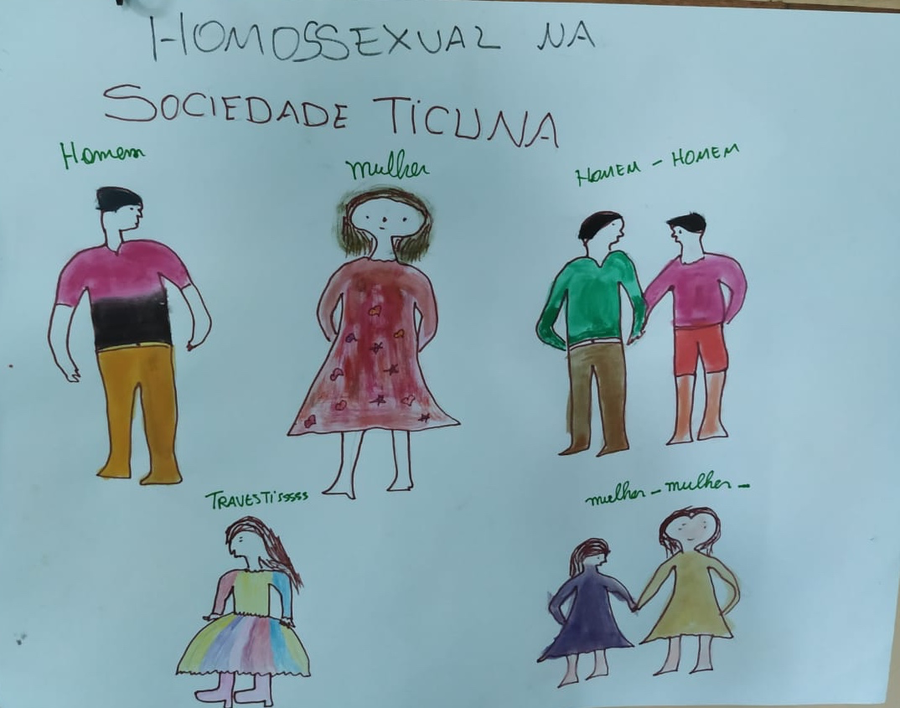
Sexuality and the Ticunas
The anthropological field works the representation of gender for indigenous people by their social division of labor. Those men who feel and perceive themselves early as women are part of the group of women and vice versa, but there are different forms of acceptance.
With the Ticuna, in villages closer to larger urban cities the denial is more pronounced and there is more stigma and violence.
In distant villages no denial action is observed and leaderships accept such conditions.
There is recognition of indigenous men who have sex with men and indigenous women that have sex with other women; and persons who are transgender/travestis, as illustrated during a workshop early 2019.
Source: Drawings from a Workshop with Ticuna people for elaboration of educational material ( BR MoH/UNESCO; 2019)
Notes:
These drawings are from workshops conducted with TICUNA people in May 2019, coordinated by a colleague researcher, Ivo Brito with the support of UNESCO Brazil. The anthropological field works the representation of gender for indigenous people by their social division of labor. Those men who feel and perceive themselves early as women are part of the group of women and vice versa, but there are different forms of acceptance.
With the Ticuna, in villages closer to larger urban cities the denial is more pronounced and there is more stigma and violence.
In distant villages no denial action is observed and leaderships accept such conditions.
There is recognition of indigenous men who have sex with men and indigenous women that have sex with other women; and persons who are transgender/travestis, as illustrated during a workshop early 2019.

Slide 22
Transsexuals
I was born like this
I am like this
Source: Workshop with Ticuna people
for elaboration of educational material
( BR MoH/UNESCO;2019)

Slide 23
CONCLUSION

Slide 24
Conclusions
When we look at the HIV/AIDS data available, the social determinants, vulnerabilities and social representations of health and sexuality of the Indigenous people in Brazil, and consider the implications for HIV prevention and sexual health care in general, we can say that:
a. Contextual factors and social determinants influence HIV and STI acquisition by Indigenous populations.
b. There is need for data crossing from the different data banks available in the country.
c. Its’ essential to use qualitative methodologies to complement quantitative data available.
d. Highlight the importance to have the participation of the indigenous population in the development and implementation of health policies to ensure effective programs in both urban and rural areas.

Slide 25
References
Brasil, Instituto Brasileiro de Geografia e Estat.stica (IBGE), “Os Indígenas no Censo Demográfico de 2010: primeiras considerações com base no quesito cor ou raça” Rio de Janeiro, 2012.
Pereira, Nilza de Oliveira Martins et. al. “Perfil Demográfico Socioeconômico das Pessoas que se Autodeclararam Indígenas nos Censos Demográficos de 1991 e 2000”. In Heloisa Pagliaro, Marta M. Azevedo e Ricardo Ventura Orgs. Demografia dos Povos Ind.genas do Brasil. Editora FIOCRUZ, 2005. 192 p. ISBN: 85-7541-056-3. Available from SciELO Books <http://books.scielo.org
Wong, Laura l. Rodriguez “Tendências da fecundidade dos povos indígenas nos Censos Demogr.ficos brasileiros de1991 a 2010”. Revista Brasileira de Estudos de População, Rio de Janeiro, vol. 33, No. 2, pag. 399-421, maio/agosto,2016.
Brito, Ivo “Tendências e characterísticas da epidemia do HIV/Aids entre os povos indígenas. Uma abordagem etnoepidemiológica”. In Sexualidades Indígenas, Ivo Brito (org), Brasília, Editora Paralelo 15, 2011.

Slide 26
Acknowledgements
Ivo Brito – Literature review and field research –
Ministry of Health, DCCI- STI/HIV/VH Coordination, Brasilia, Brazil.
Monitoring and Evaluation Team– HIV Clinical Monitoring and Cascade Data- Ministry of Health, DCCI- STI/HIV/VH Coordination, Brasilia, Brazil.
UNESCO Brazil – Support for the workshops conducted in 2018.
Support - National Institute of Infectious Disease- INI-FIOCRUZ, Rio de Janeiro, Brazil.

Slide 27
Thank you! Gracias! Obrigado!
cpimenta@gmail.com
www.aids.gov.br

